Slide 1
RESTful APIs
Designing APIs in the REST style with examples in ASP.NET Web API
Presented by
Gregory M. Sohl

Slide 2
Assumptions
Basic understanding of HTTP
A little C#
A little ASP.NET

Slide 3
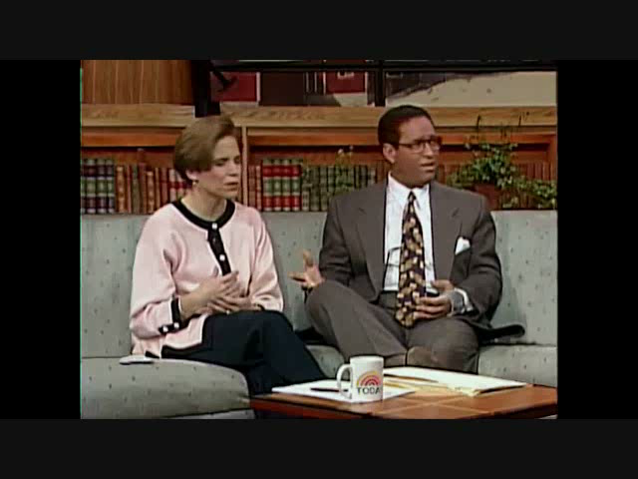
Background
Described in Roy Fielding dissertation in 2000
Roots back to 1994
Roy was a key contributor to HTTP and URI
Style of building APIs in distributed hypermedia systems
It is not
Particular Framework or Technology
Set of Standards
Design Pattern

Slide 4
REST
REprestational State Transfer
Transfer representations of resources in a particular State
Based on architectural style of WWW
Set of Constraints

Slide 5
Concepts
Resource
Has a URI
Conceptual mapping to one or more entities
URI
Address to a resource, it’s primary key

Slide 6
Concepts
Representation
Snapshot of a resource
NOT the resource itself
Media Type
A format for the representation
Commonly JSON or XML – but no limits

Slide 7
Constraints
Client / Server
Duh, it’s an interface from one thing to another
Separation of Concerns
Independent evolution
Stateless
Each request is independent
No stored context on the server

Slide 8
Constraints
Cache
Responses must indicate
Clients can choose to reuse
URIs
Resources are identified by URIs
Nouns instead of Verbs
Multiple URIs can refer to the same resource

Slide 9
Constraints
Uniform Interface
Resource based
HTTP verbs
POST, PUT, GET, DELETE, HEAD (for conditional GETs)
Generally ignore others, e.g. OPTIONS, PATCH and TRACE
HTTP result codes
Self-descriptive messages
Generalized media types

Slide 10
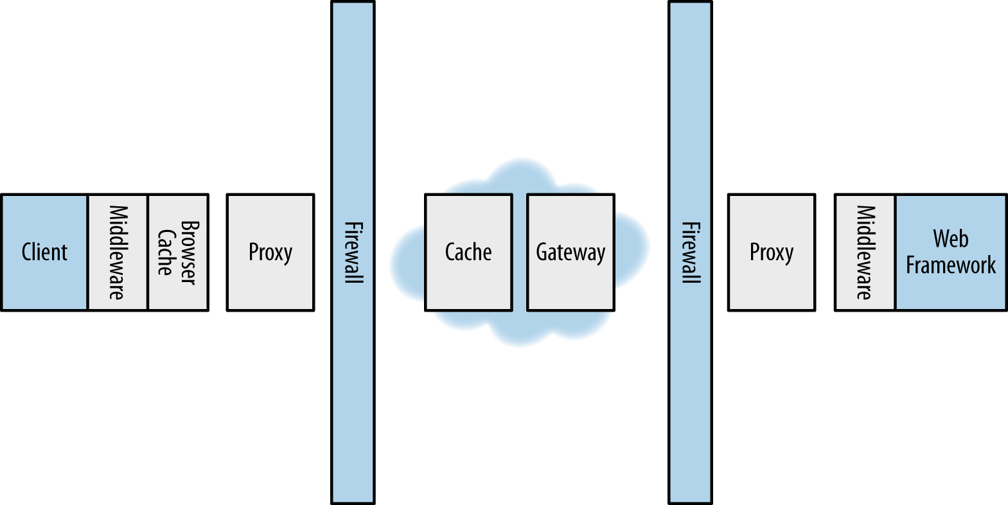
Constraints
Layered System
Client not necessarily talking directly to server
Layers can only “see” each other
Supports firewalls, proxies, etc.

Slide 11
Constraints
Code on Demand
Server can download code – change client behavior
Simplify client dev
Optional constraint

Slide 12
URIs
URIs are resource based – nouns
Verbs come from HTTP methods, GET, POST, PUT, DELETE
Use slashes to indicate resource hierarchy
http://myapi.com/{resource}
http://myapi.com/{resource}/{id}/{document}
http://myapi.com/{resource}/{id}/{child resource}

Slide 13
URIs - Contrast to SOAP
SOAP methods
GetCustomerList()
AddNewCustomer()
GetCustomerInfo()
UpdateCustomer()
DeleteCustomer()

Slide 14
URIs - Contrast to SOAP
REST Requests
/customers
GET - retrieve a list of customers
POST - create a new customer
/customers/{customer id}
GET - retrieve information about a customer
PUT - update a customer's information
DELETE - remove a customer

Slide 15
HTTP Verbs
HTTP Verbs
Verb | Usage
GET | read
HEAD | like GET, but returns only headers
POST | create and other uses
PUT | update
DELETE | remove
OPTIONS | documentation

Slide 16
Building a RESTful API in .NET
ASP.NET
Sites
MVC
Web Forms
Services
Web API
Web Pages
SPA
SignalIR
ASP.NET - Great platform for REST style
Web API is specifically built for REST
Many facilities and helpers built in

Slide 17
HTTP Status Codes
1xx – Informational – seldom used
2xx – Success
3xx – Redirection, unchanged. Client should do something different to complete the request.
4xx – Client action caused an error
5xx – Server error

Slide 18
Common HTTP Status Codes
200 OK – Request worked. Nothing to report
201 Created – Indicate new resource created
204 No Content – Used with conditional GETs
304 Not Modified – Used with

Slide 19
Common HTTP Status Codes
401 Unauthorized
404 Not found
500 Internal Server Error – Include details in body
503 Service Unavailable – Under maint, etc.

Slide 20
API Design
Art or Science?
Request Types
Safe – No side effects
Idempotent – Multiple requests have same effect
Method | Safe | Idempotent | Cachable
GET | Yes | Yes | Yes
POST | No | No | No
PUT | No | Yes | No
DELETE | No | Yes | No

Slide 21
API Design
URIs
Sensible names – using nouns
Forward slashes for hierarchical relationships
Use dashes in multi-word resource names for readability
Consistent use of lowercase resource names
Avoid file extensions
Fine grained to support caching

Slide 22
API Design
Representation Formats
Choose appropriate media types
JSON, XML, domain specific
Client indicates preference via Accept header

Slide 23
Caching
Responses indicate cachability of result
Use Cache-Control header
Use Expires header
Generate ETag header
Unique for a resource version
Using an Etag
Use for GET & PUT

Slide 24
Caching – Why??
The internet caches
Some requests are expensive
Increase throughput

Slide 25
Related Info In Results
Favor links instead of related keys

Slide 26
User Group Demo
User groups and their city
API
/usergroups
GET, POST
/usergroups/{id}
GET, PUT, DELETE
/usergroups/{id}/map

Slide 27
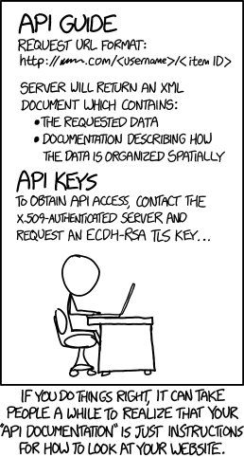
Documentation
Doc needs are not unlike for any API
URIs
Methods
Parameters
Data formats
Response codes
Samples

Slide 28
Why REST
HTTP is Ubiquitous
Lighter weight than SOAP
Caching Support
Acceptance
Scales well
Decoupled

Slide 29
Resources
Tutorial
http://www.restapitutorial.com
Best Practices PDF
http://www.restapitutorial.com/resources.html
Books
Designing Evolvable Web APIs with ASP.NET
http://chimera.labs.oreilly.com/books/1234000001708/index.html
RESTful Web Services Cookbook
http://www.amazon.com/RESTful-Web-Services-Cookbook-Scalability/dp/0596801688

Slide 30
Resources
Courses
http://www.pluralsight.com/courses/rest-fundamentals
Caching Management Library - Cache Cow
http://www.hanselman.com/blog/NuGetPackageOfTheWeekASPNETWebAPICachingWithCacheCowAndCacheOutput.aspx

